Slide 1

AVE14
Result Sheet Preliminary Research
Hand in by email

Slide 2
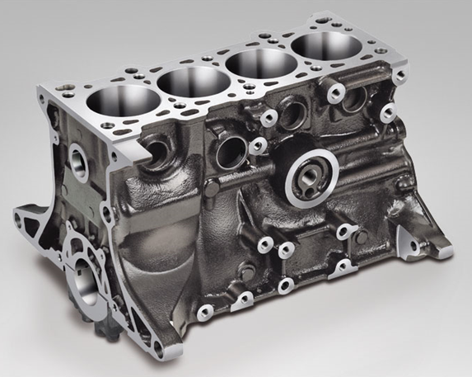
Overview Assignment
Aspects | Comment
Cylinder Block Functions | Mention and illustrate at least 8 functions of your cylinder block, and mention at least 1 source
Casting Process | Find out which casting processes are possible and explain which process you think has been used your chosen cylinder block. Give at least 2 sources.
CAD Model Water Core | Take care of a clear representation of the block (several views)
Cooling Research | What is the cooling fluid lay-out?
 | Which cooling principle is being used?
 | Calculate mass flow and cooling pump power and explain your calculation (take care of the units)
Cylinder Block (right) is the one-piece component that houses for example crankshaft and pistons. It is not the complete engine!

Slide 3
Who
Fill in your names.
Names: Max Janissen en Rik Veerhoek

Slide 4
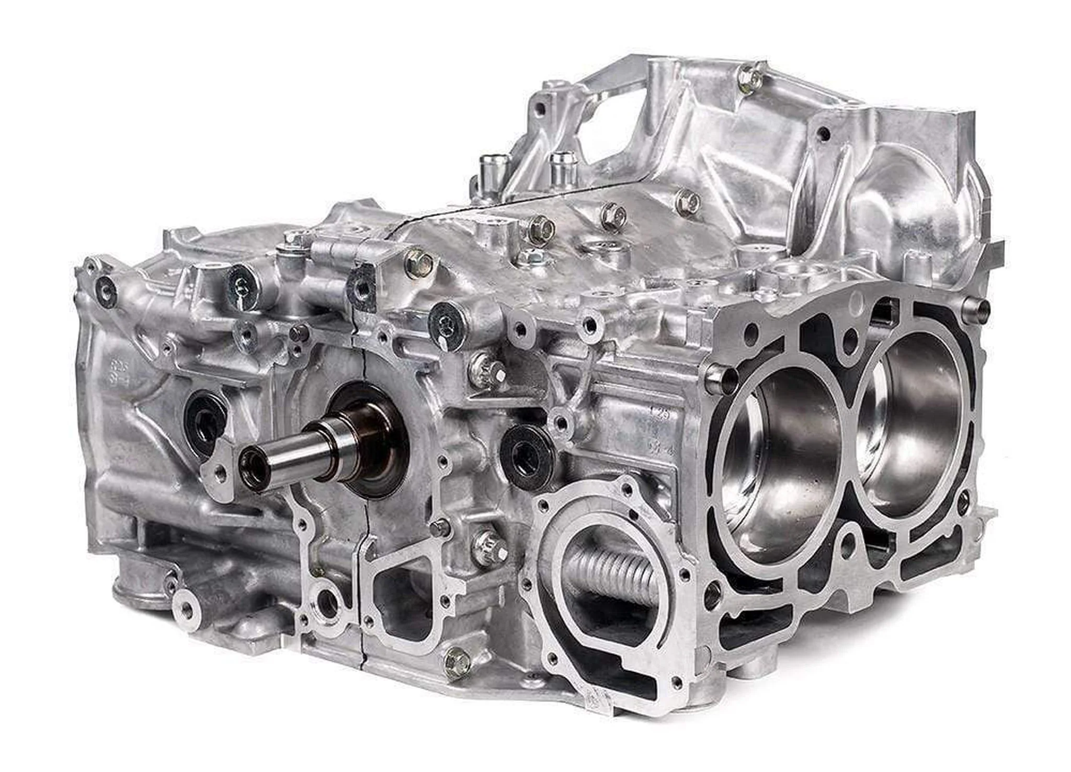
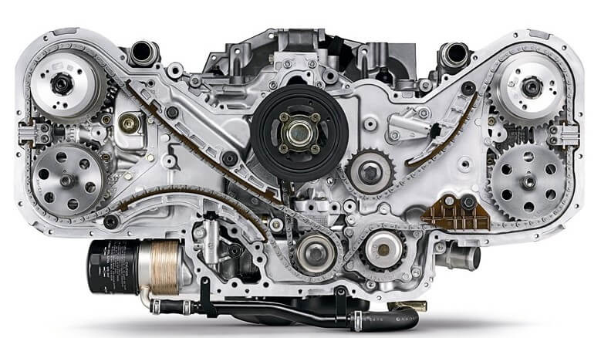
Engine Specs
Add pictures of the engine you have chosen as well as the main specs. Is there a special reason for choosing this engine?
You are not supposed to use engine choice and results from previous years, this will be checked!

Slide 5
Functions & Manufacturing
Look into the design of your cylinder block.
Functions: Each cylinder block feature has a reason and a function. Mention at least 8 functions for your own cylinder block, as well as at least one source.
Manufacturing: Research how cylinder blocks are being cast in general and how your cylinder block is cast in particular.

Slide 6
Functions
Indicate at least 8 functions of your cylinder block, and provide at least one source.
Source: https://www.youtube.com/watch?v=2IEiA6cbtCg
Functions:
Combustion
Cooling
Lubrication
Conduct
Heat transfer
Power transmission
Housing crankshaft
Supporting cylinders

Slide 7
Casting Process
Explain the casting process of a cylinder block: (1) Which casting processes exist in general, (2) which processes are used for cylinder blocks, en (3) which casting process do you think has been used for your cylinder block (and why)? Mention your sources.
Casting types:
Sand casting
Die casting
Investment casting
Gravity Die casting
Continuous Casting
Shell molding
Lost-foam casting
High pressure die casting
Centrifugal casting
Permanent mold casting
Vacuum casting
Low-pressure casting
Squeze casting
Plaster casting
Casting cylinder blocks:
Sand casting
Die casting (aluminium)
Used casting process at our block:
For our block we think it is made via sand casting but as it is made out of aluminium it could also been casted via die casting.

Slide 8
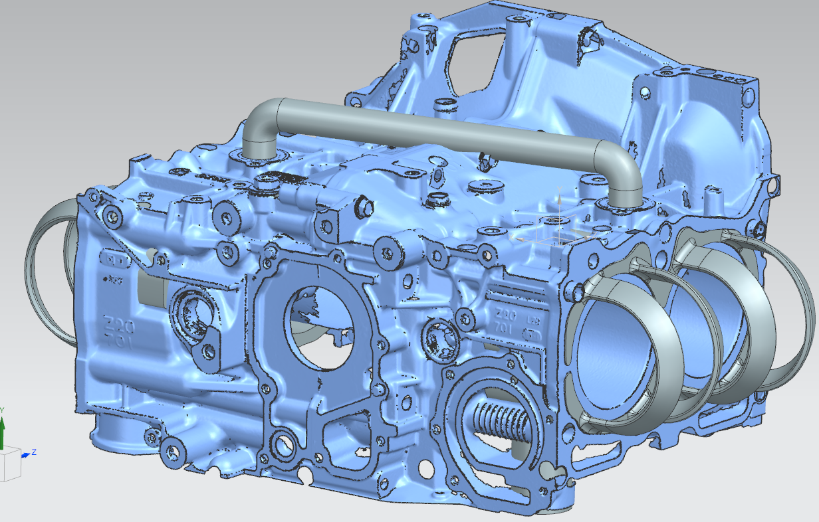
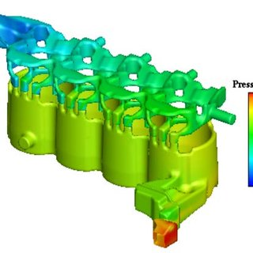
CAD Model
Create a CAD Model of the water jacket (internal volume) of your own cylinder block and show the model in different views.
The water jacket actually is the internal volume of the casting piece, between the outer wall and the cylinders. See the example at the right (water volume of both cylinder block and cylinder head).

Slide 9
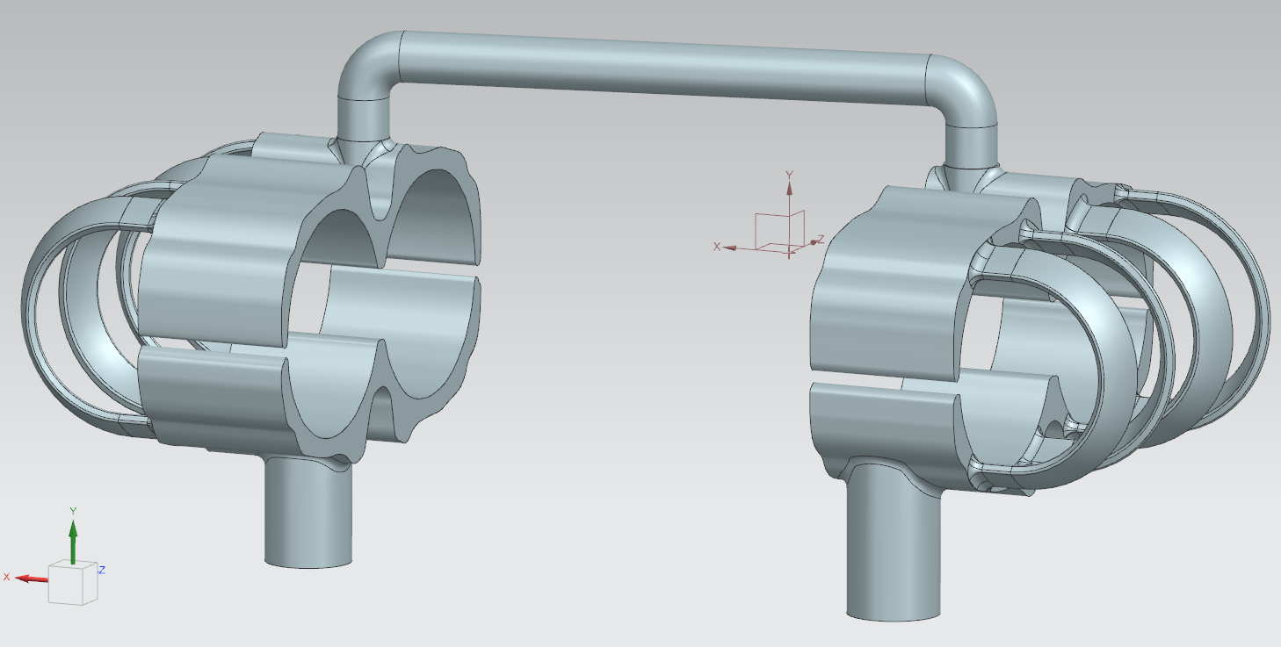
CAD Model
Create a CAD Model of the water jacket (internal volume) of your own cylinder block and show the model in different views.

Slide 10
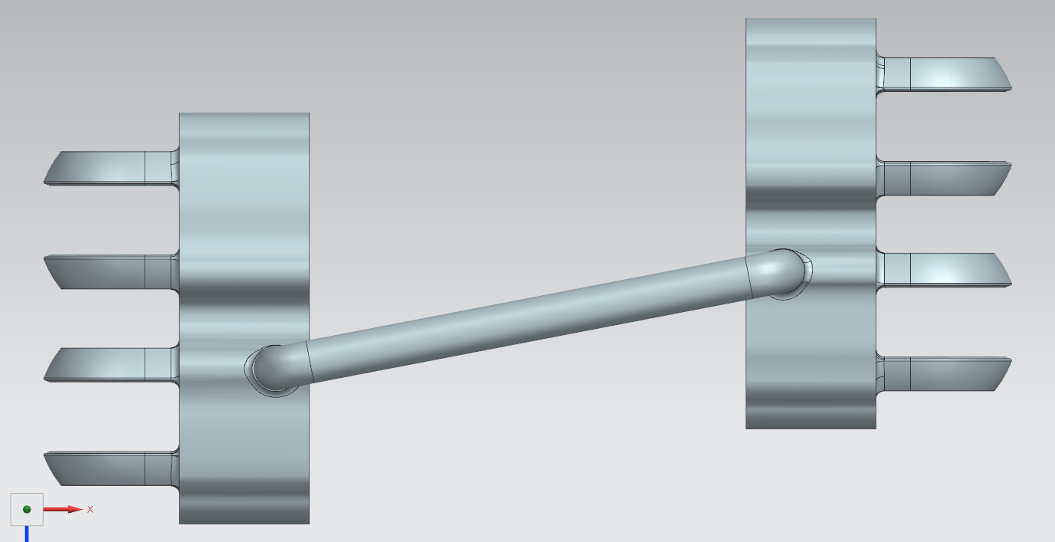
CAD Model

Slide 11
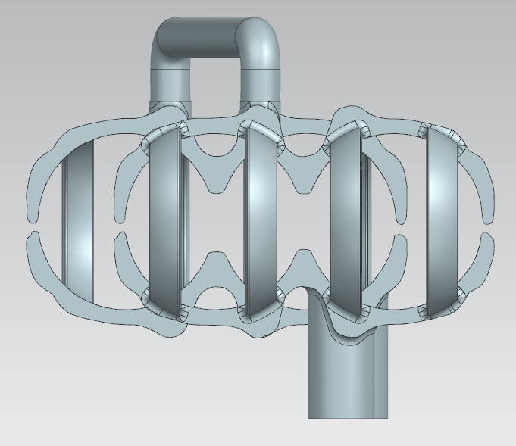
CAD Model

Slide 12
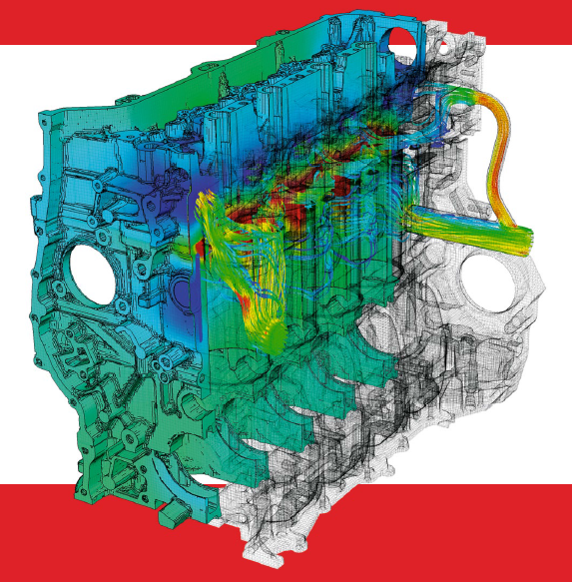
Cooling Research
Cooling Flow: Research how the cooling fluid flows through your cylinder block (inlet, outlet). Which cooling principle (series, parallel, cross-flow) is being used?
Input Values: Estimate input values for cooling fluid mass flow and combustion heat through the cylinder liners to the cooling fluid for your own cylinder block.
See next sheets for further explanation.

Slide 13
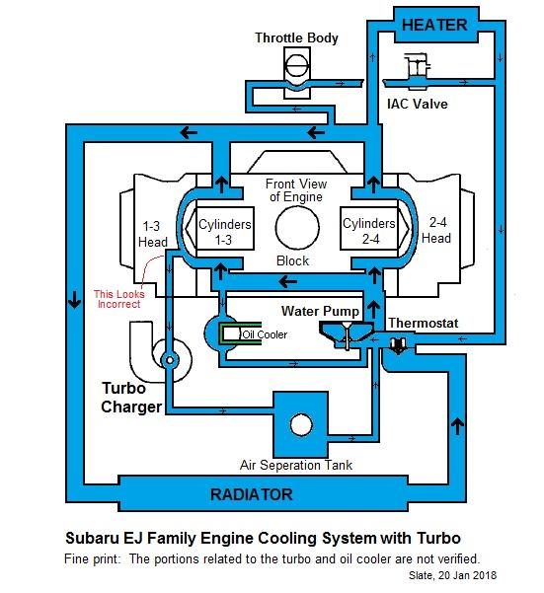
Cooling Research Cooling Flow
Cylinder Block Flow: Use pictures to show how the cooling fluid flows through your cylinder block. Mention your sources. Which flow principle has been used (series, parallel, crossflow)?
Sources:
https://www.thesamba.com/vw/forum/viewtopic.php?t=693020&postorder=desc
Principle used in our cylinder block:
Parallel

Slide 14
Cooling Research Simulation Input
Input Values: Provide your input values in the table below.
Input Values
Engine Power | 85 | kW
Cooling water mass flow (own calculation) | 4,057 | Kg/s
Cooling water inlet temperature (range 80 – 95 C, own choice) | 80 | C
Heat load (1 cylinder) | 8,5 | kW
Explain the calculation of cooling water mass flow and cylinder heat load, like the examples on the next sheets.

Slide 15
Cooling Research Mass Flow estimation
Example estimation mass flow cooling water:
Engine (mechanical) power 80 kW
Assumption: Fuel power is equally split into mechanical power, cooling water power and exhaust power (33% each)
This means cooling water power is also 80 kW, just like mechanical power
Assume the cooling water heats up 5 C inside the engine, this is a plausible value
Then estimate the required mass flow to transport the 80 kW heat load using the (well-known) formula Q = ṁ.c_{p}.∆T.
The resulting mass flow value is input for your simulation.

Slide 16
Cooling Research Heat Load estimation
Example estimation Heat Load from the combustion:
Engine (mechanical) power 80 kW
Assumption: Fuel power is equally split into mechanical power, cooling water power and exhaust power (33% each)
This means cooling water heat resulting from the combustion is also 80 kW, like mechanical power
In case of a 4 cylinder engine: Heat load is 20 kW per cylinder
Heat is transported from combustion to cooling water through cylinder head, piston and cylinder liner
Assumption: 40% of the combustion heat is transferred through the liner, then the heat load for 1 cylinder liner is 8 kW
This value is input for your simulation model (for each cylinder separately)
The resulting mass flow value is input for your simulation.

